Slide 1

EDA to understand how consumer attributes and loan attributes influence the tendency of default

Slide 2
Business Objective
This case study aims to identify patterns which indicate if a client has difficulty paying their instalments which may be used for taking actions such as denying the loan, reducing the amount of loan, lending (to risky applicants) at a higher interest rate, etc. This will ensure that the consumers capable of repaying the loan are not rejected. Identification of such applicants using EDA is the aim of this case study. In other words, the company wants to understand the driving factors (or driver variables) behind loan default, i.e. the variables which are strong indicators of default. The company can utilise this knowledge for its portfolio and risk assessment.

Slide 3
Suggesting Missing Value treatment
As We are performing EDA only and we are not going to build any model, so here it's not necessary to treat missing values. So we are just suggesting the missing value traetment approaches based on above analysis and not actually replacing the missing values.
AMT_ANNUITY has continuous value and it's distribution is not symetrical, we can use Median imputation to treat missing values in this column.
AMT_GOODS_PRICE has continuous value and it's distribution is not symetrical, we can use Median imputation to treat missing values in this column.
NAME_TYPE_SUITE is a categorical column, we can use mode to impute the missing values.
CNT_FAM_MEMBERS and NAME_FAMILY_STATUS: Both of these Columns have 2 missing values, In NAME_FAMILY_STATUS column the missing value is mentioned as 'Unknow' and in CNT_FAM_MEMBERS columns theese are NA values. We can replace these with mode of those two columns.
EXT_SOURCE_2 : it's a continuous variable, we can replace missing values using Median imputation.
OBS_30_CNT_SOCIAL_CIRCLE, DEF_30_CNT_SOCIAL_CIRCLE, OBS_60_CNT_SOCIAL_CIRCLE, DEF_60_CNT_SOCIAL_CIRCLE:
DAYS_LAST_PHONE_CHANGE: There is a single missing value, we can use median imputation here.
AMT_REQ_CREDIT_BUREAU_HOUR,AMT_REQ_CREDIT_BUREAU_DAY,AMT_REQ_CREDIT_BUREAU_WEEK,AMT_REQ_CREDIT_BUREAU_MON, AMT_REQ_CREDIT_BUREAU_QRT: All these columns denotes Number of enquiries to Credit Bureau about the client # Nomths/Days/Weeks before application. We can use mode imputation. That will generalize it, so we are basically replacing the missing values with maximum no. of occurance of the enquiries by the bank (Number of enquires generally bank does for most of the customers).

Slide 4
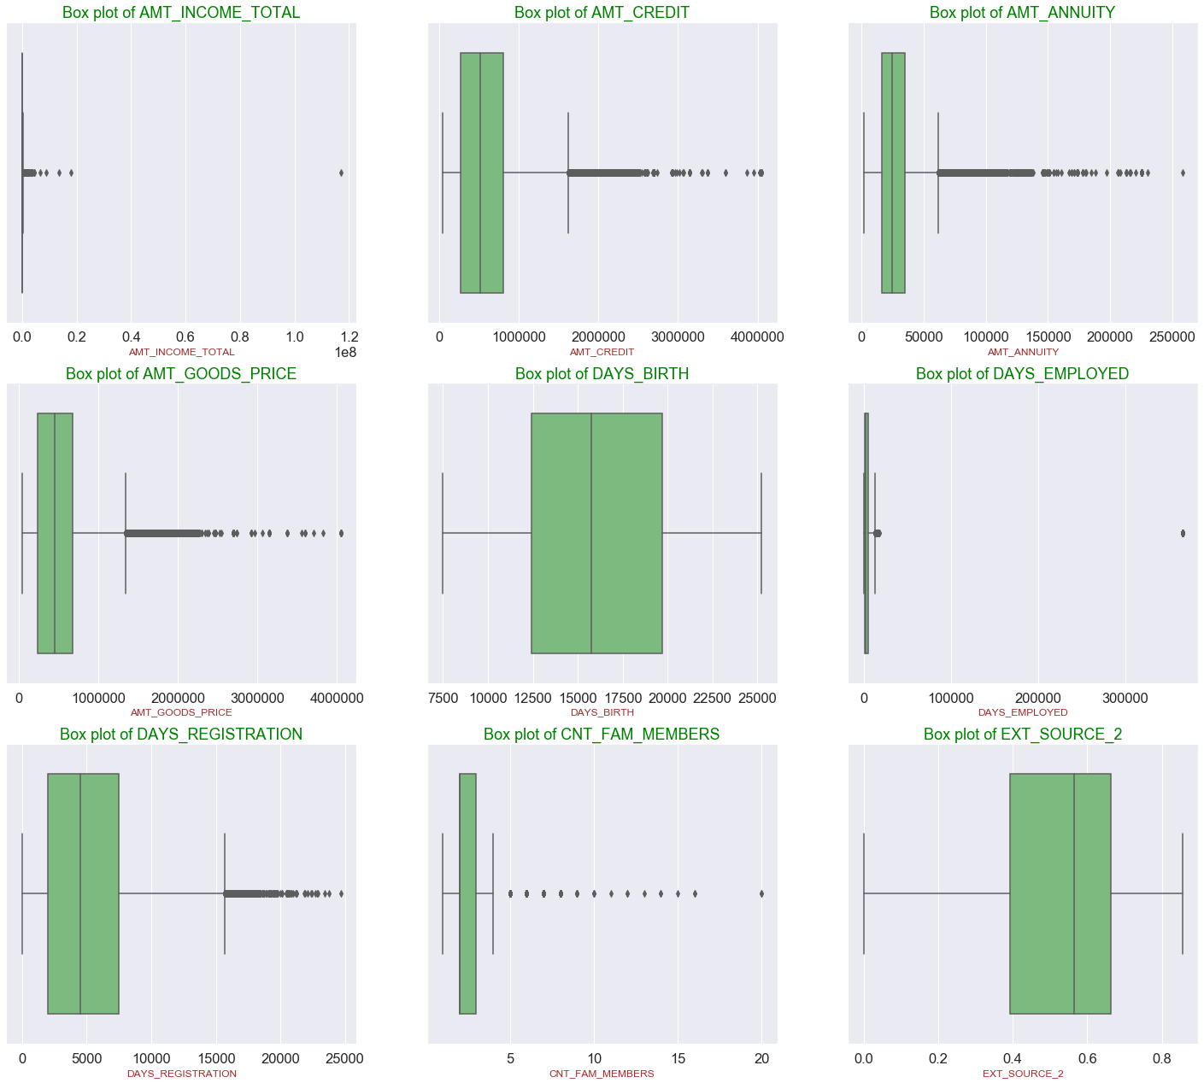
Boxplot for numerical data

Slide 5
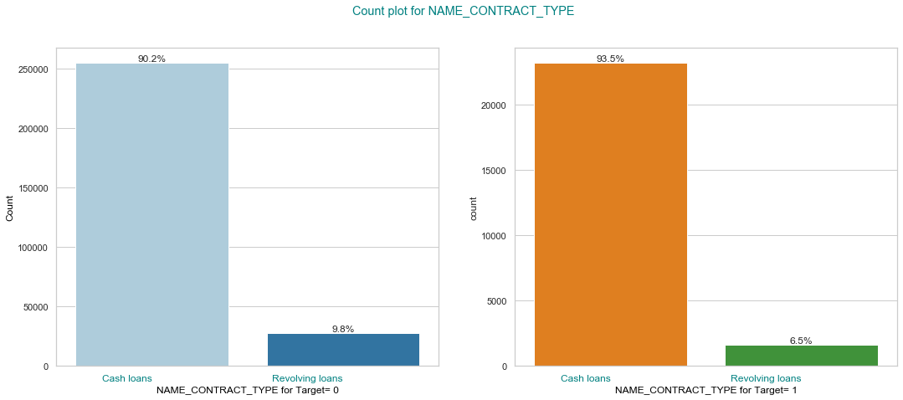
Contract type default percentage

Slide 6
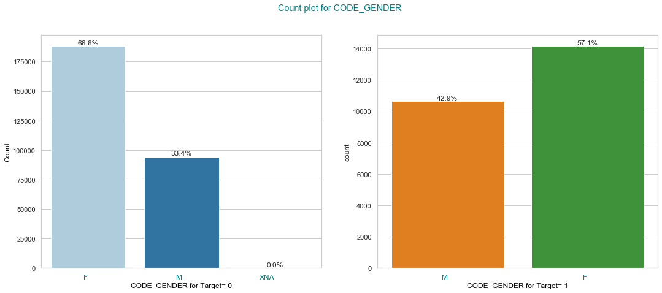
Gender default percentage

Slide 7
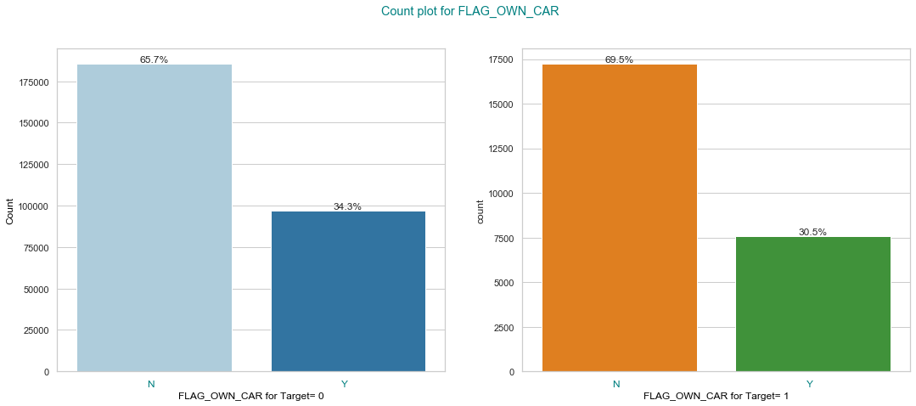
Default percentage by people who own a car

Slide 8
Percentage default by FLAG_OWN_REALTY

Slide 9
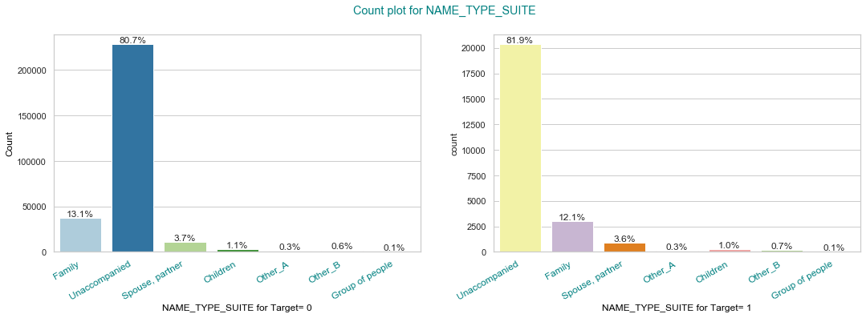
Family status vs default

Slide 10
Gender default percentage

Slide 11
Target vs FLAG_OWN_CAR

Slide 12
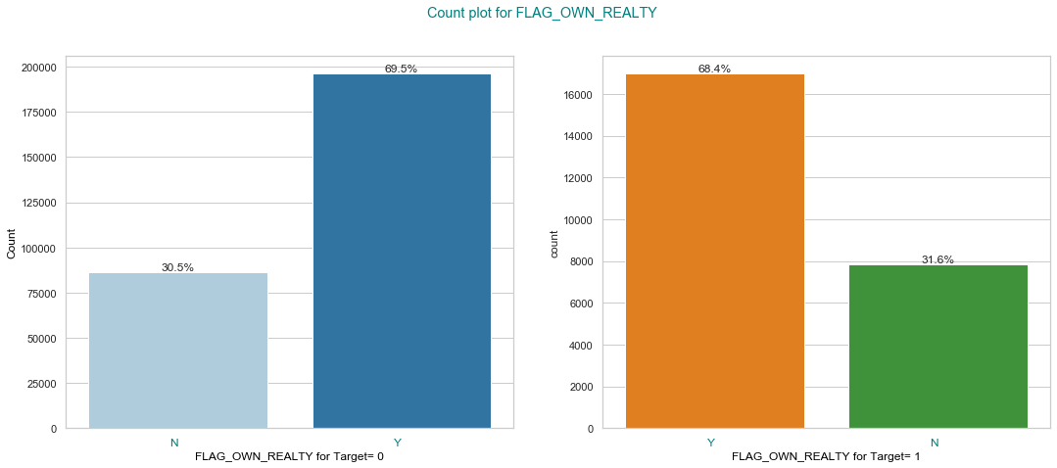
Target vs Flag own realty

Slide 13
Target vs Name Type suite

Slide 14
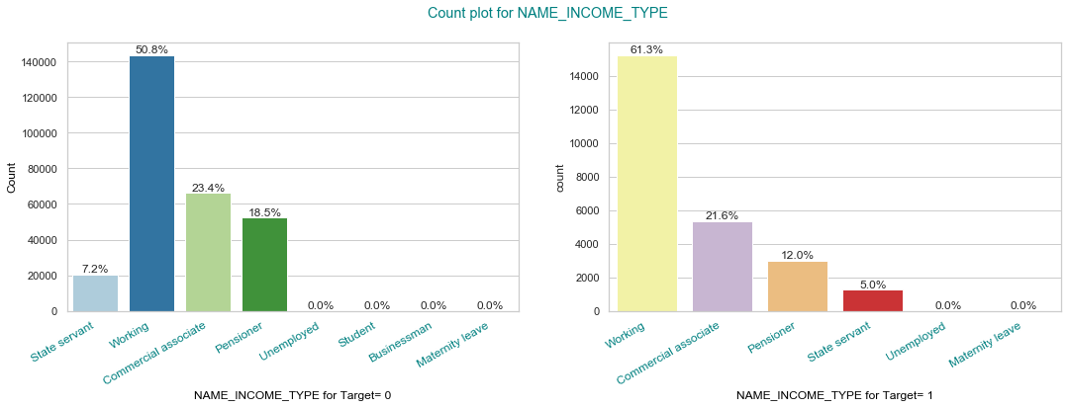
Target vs Income type

Slide 15
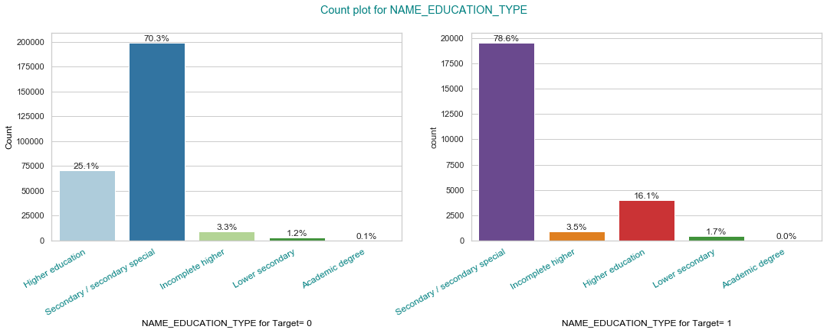
Target vs Education type

Slide 16
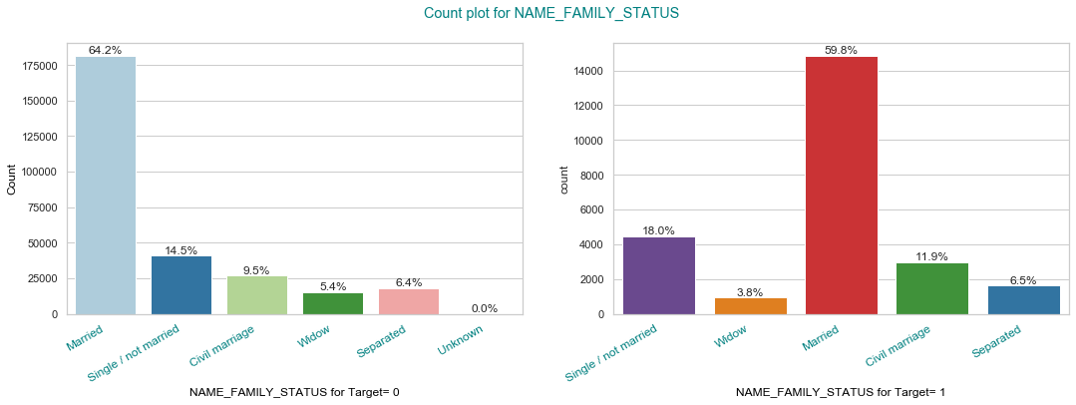
Target vs Family status

Slide 17
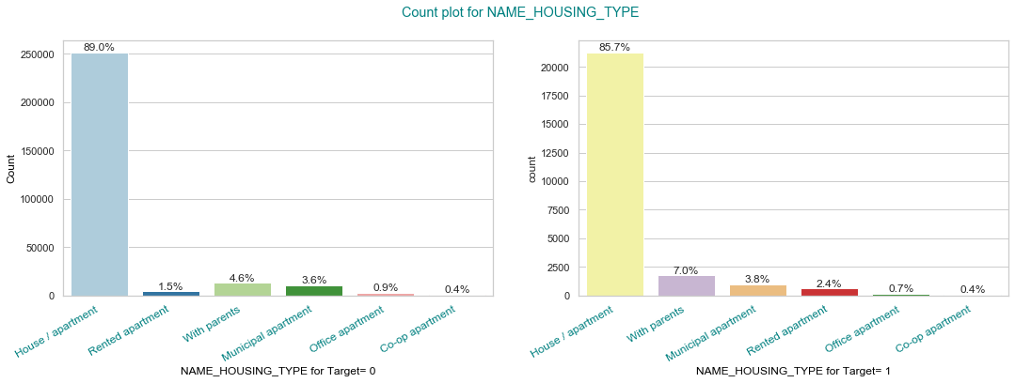
Target vs Housing types

Slide 18
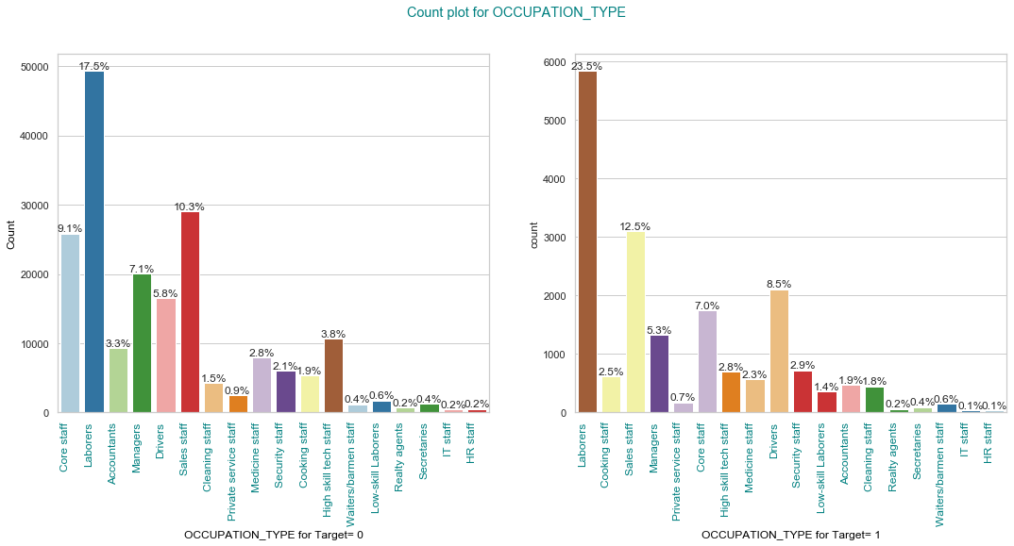
Target vs Occupation

Slide 19
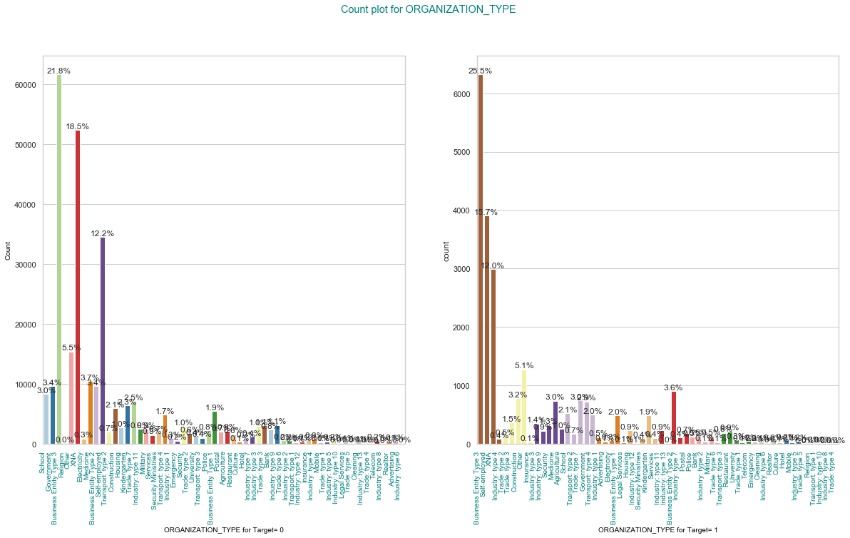
Target vs Organisation

Slide 20
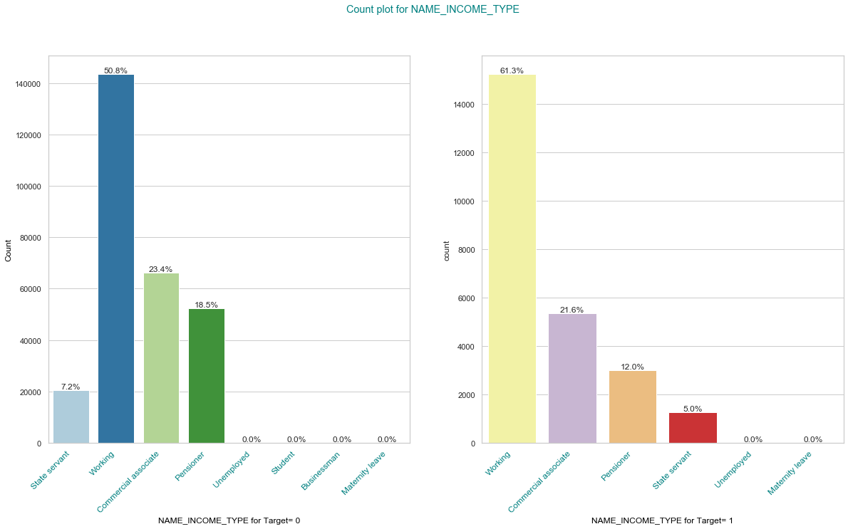
Target vs Name income type

Slide 21
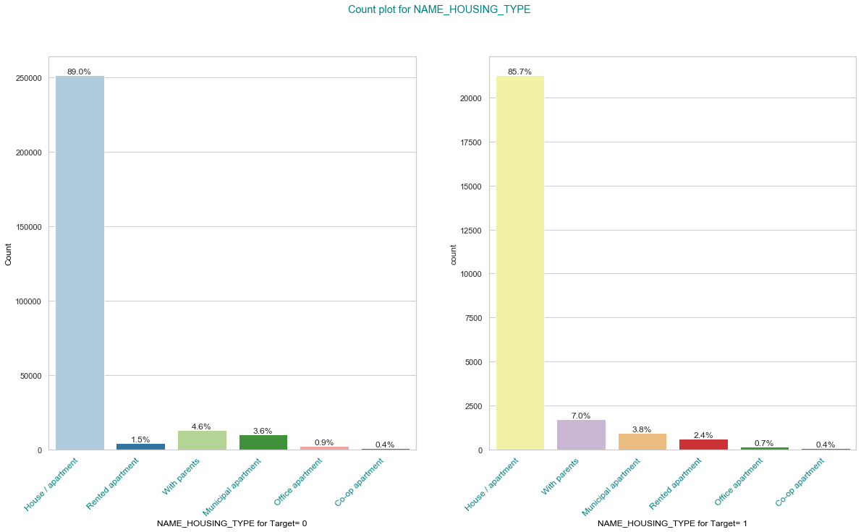
Housing Types

Slide 22
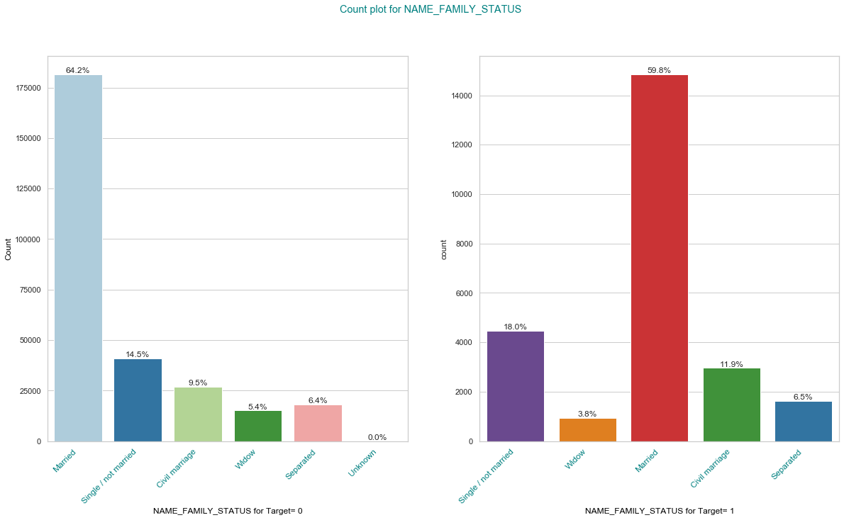
Family status vs Target

Slide 23
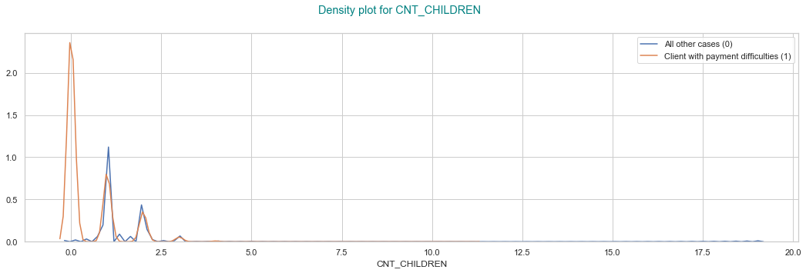
Density plot-payment difficulties

Slide 24
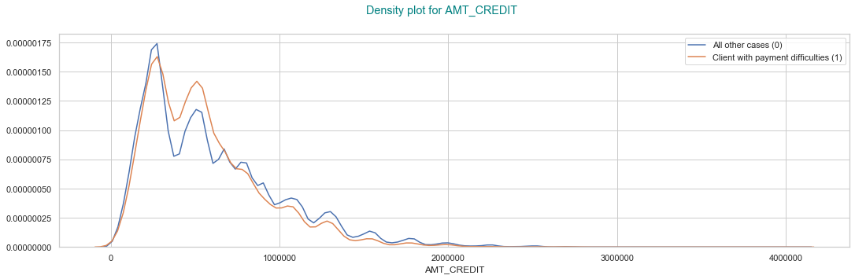
Amount credit vs payment difficulties

Slide 25
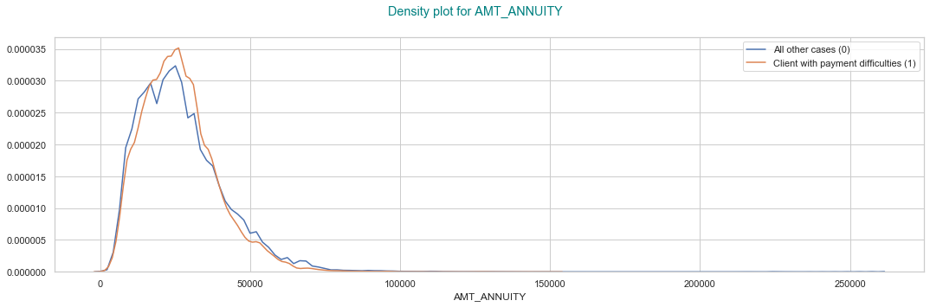
Amount annuity vs payment difficulty

Slide 26
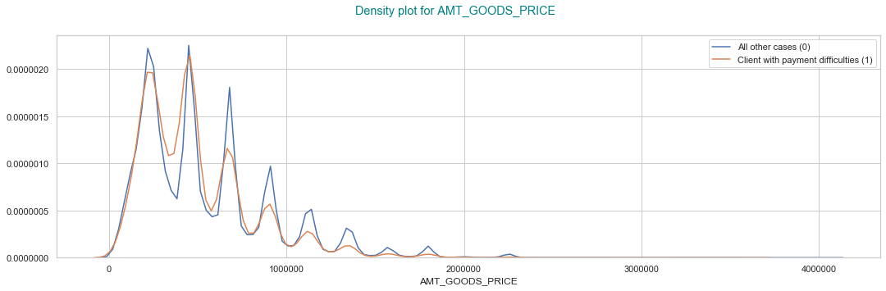
Goods price vs payment difficulty

Slide 27
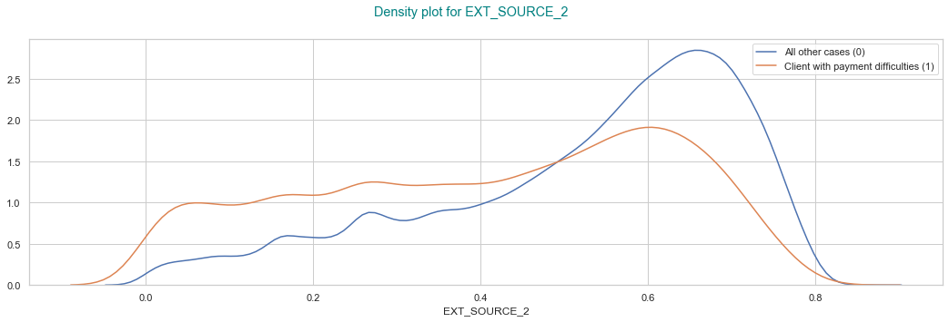
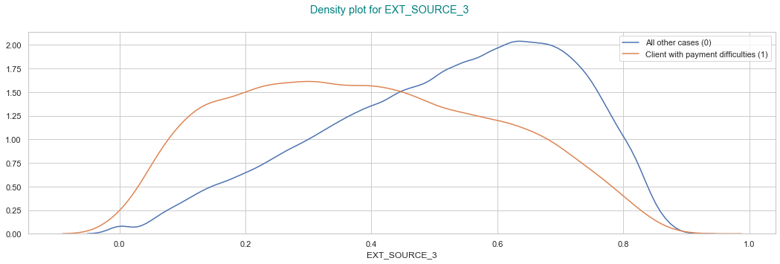
Payment difficulties vs categories

Slide 28
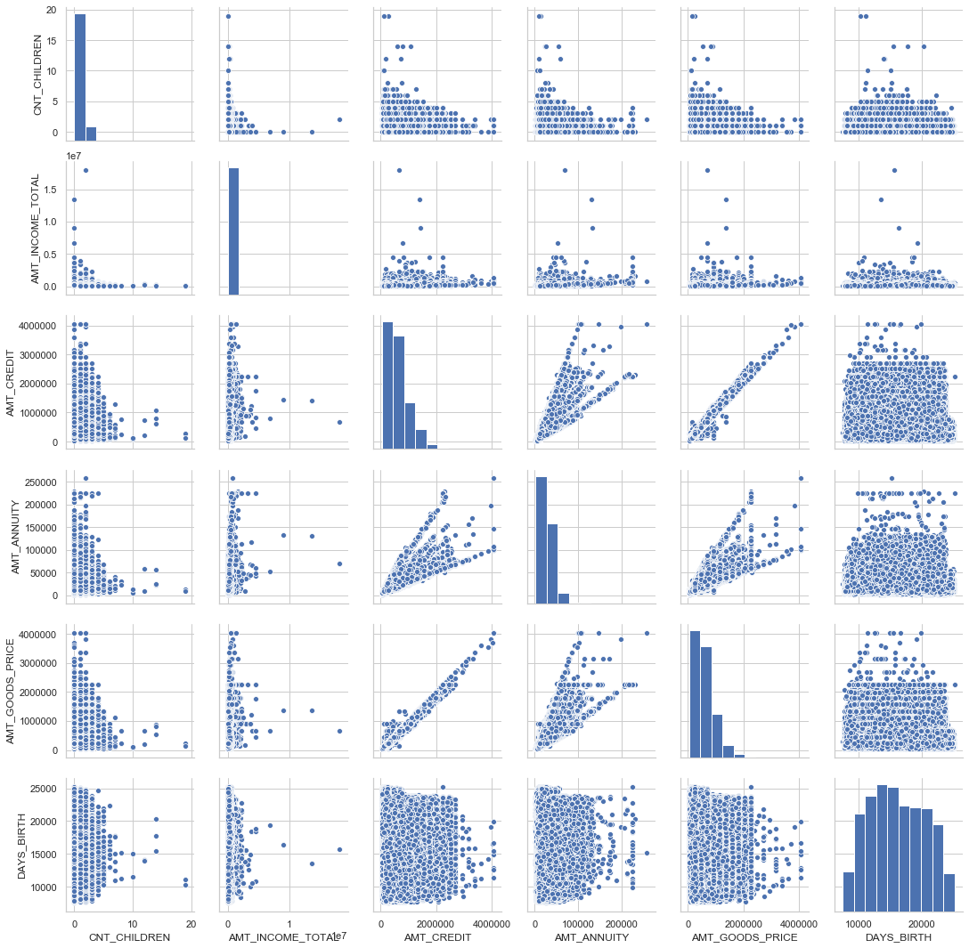
Bi-variate Analysis of Numeric and Numeric Variables

Slide 29
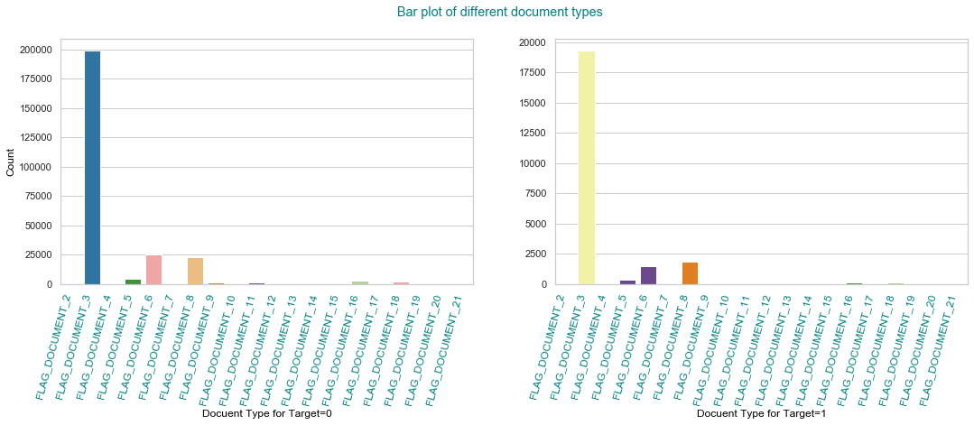
Plot for different documents

Slide 30
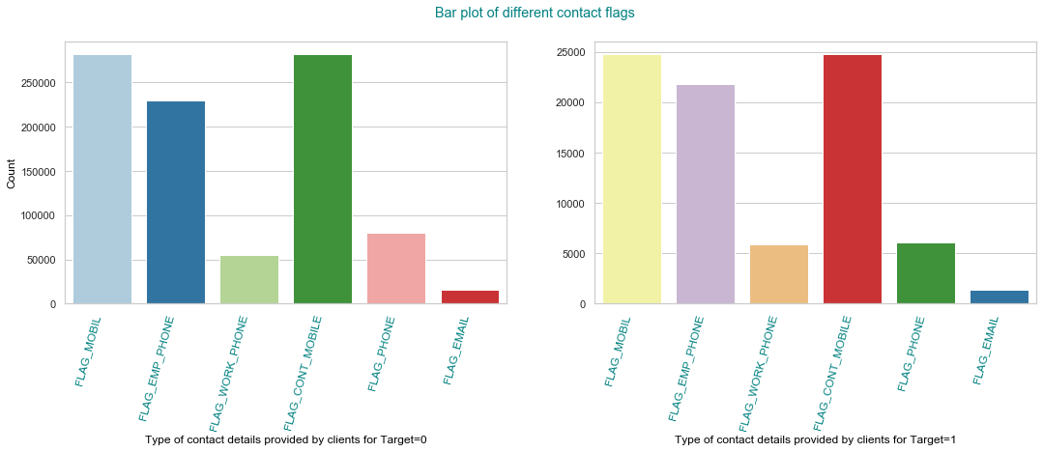
Bar plot of different contact flags

Slide 31
AGE_GROUP vs CODE_GENDER

Slide 32
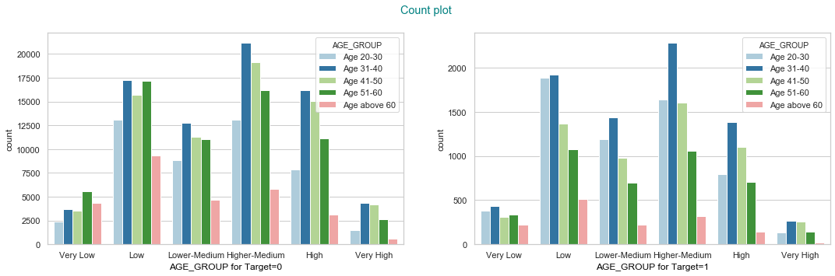
AGE_GROUP vs INCOME_SLAB

Slide 33
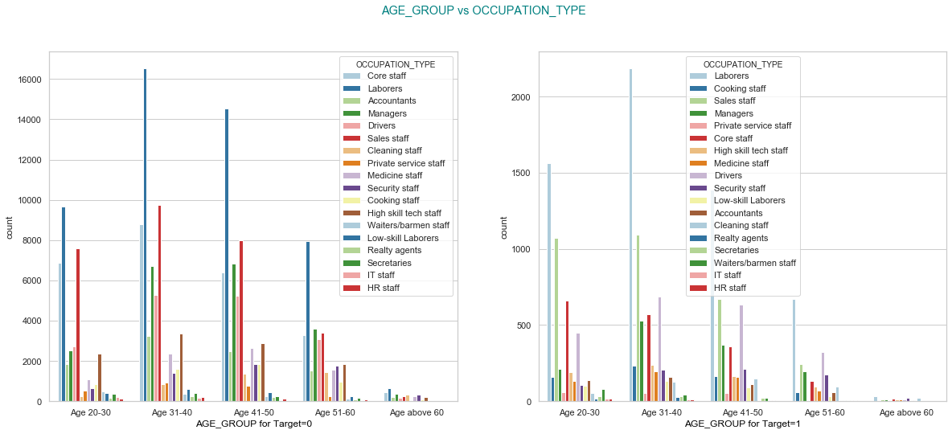
AGE_GROUP vs OCCUPATION_TYPE

Slide 34
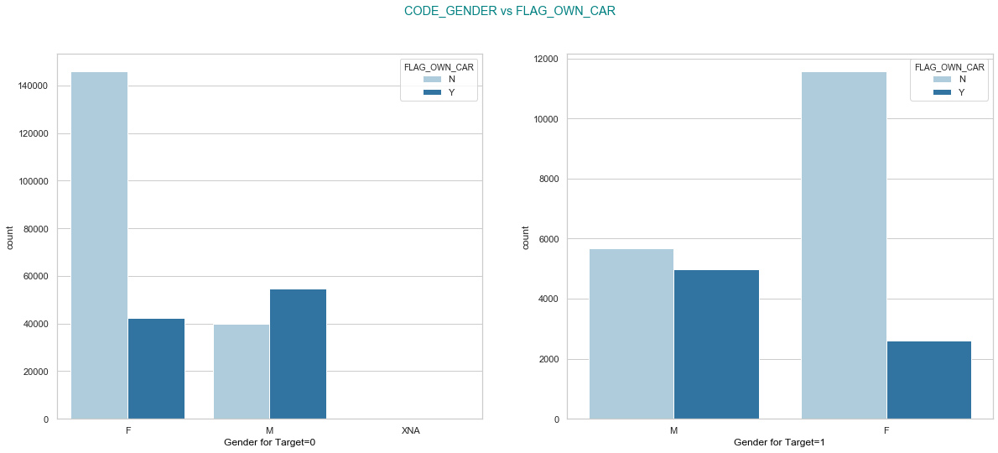
CODE_GENDER vs FLAG_OWN_CAR WITH PAYMENT DIFFICULTIES

Slide 35
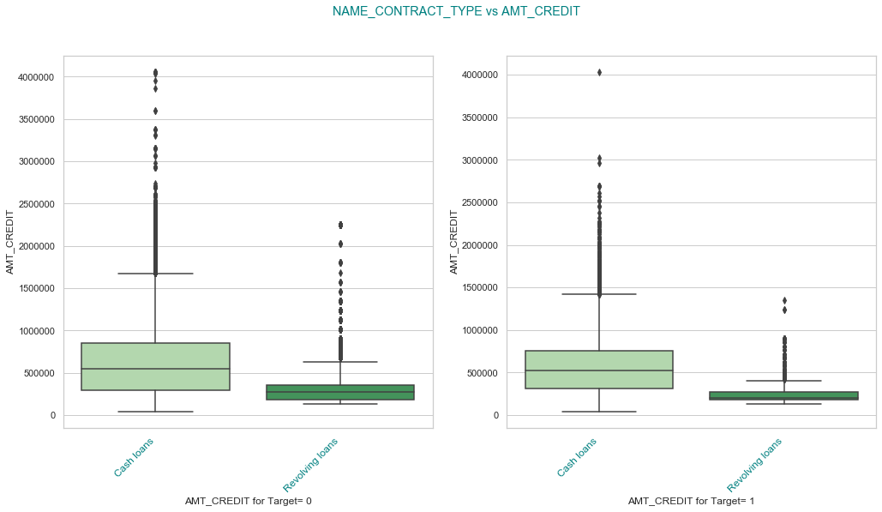
NAME CONTRACT TYPE AMT CREDIT

Slide 36
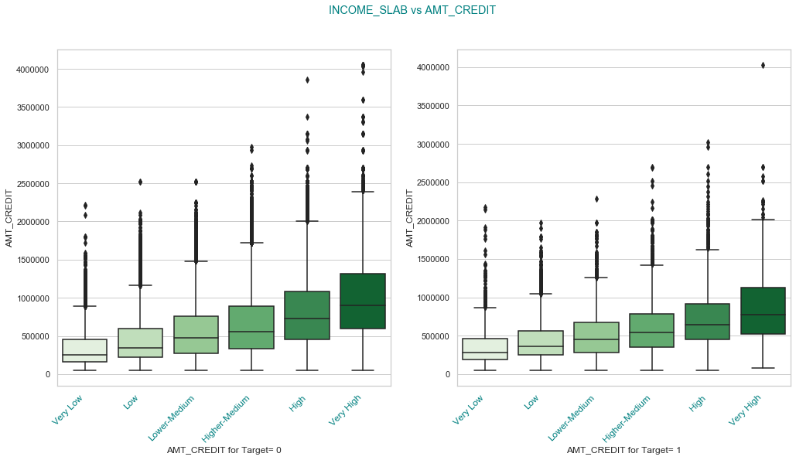
Income slab vs Amount Slab

Slide 37
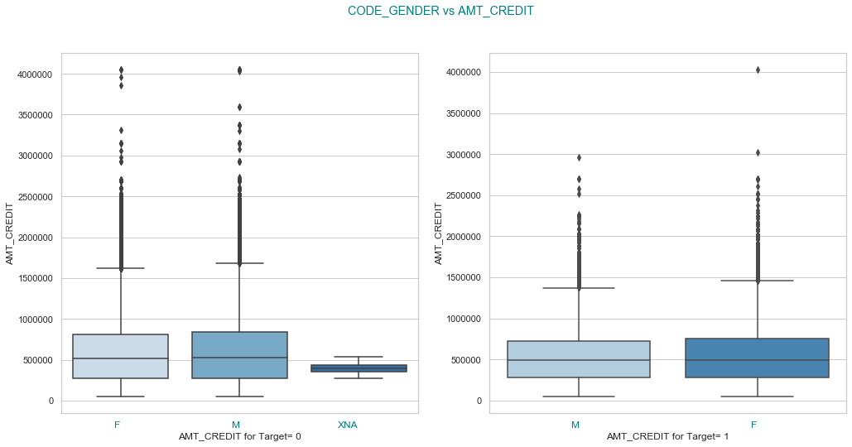
Code Gender vs Amount credit

Slide 38
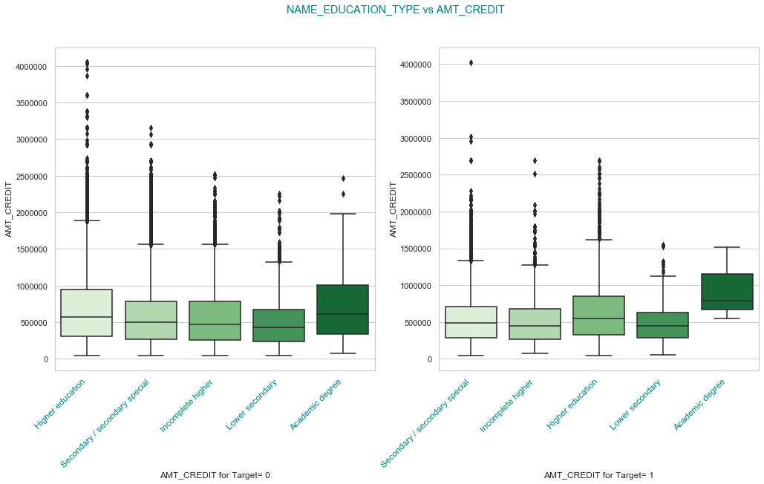
Education vs Amount

Slide 39
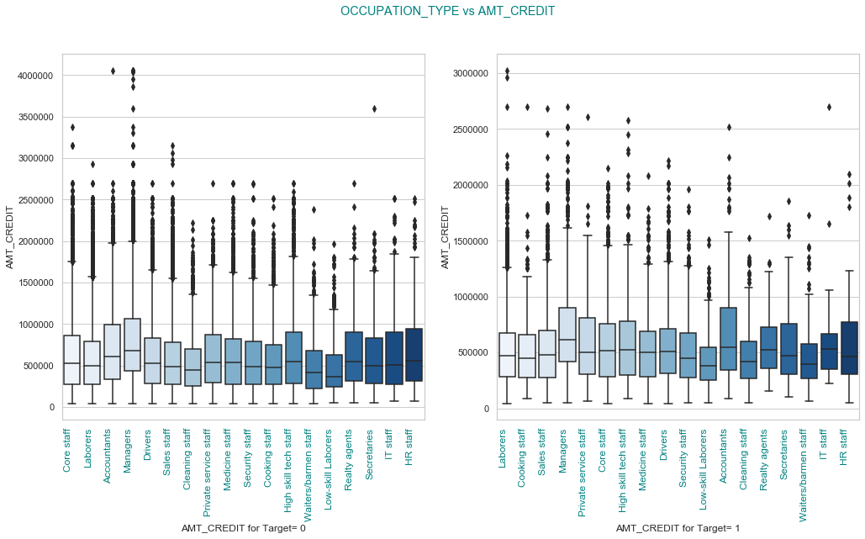
Occupation vs Amount credit

Slide 40
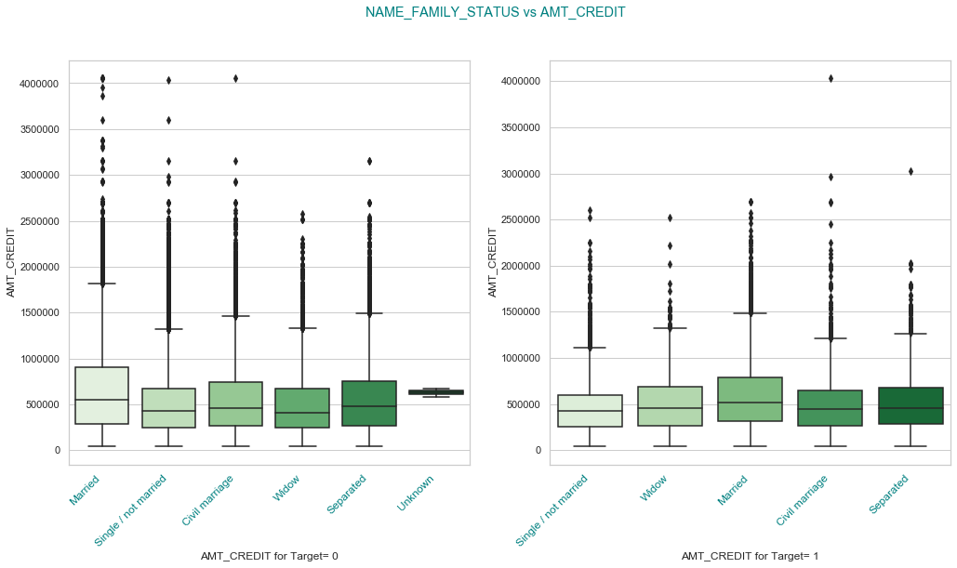
Family status vs amount credit

